Slide 1

IBM Project Presentation on “Data redundancy removal system”
By
Group ID: G12
Meet Prajapati 20162121010 BDA
Akshar Patel 20162171013 CS
Raval Mihirkumar Bhaveshkumar 20162101017 CBA
Under the Guidance of
Mr. Anoj Dixit and Prof. Sonam Singh
Institute of Computer Technology, Ganpat University
Date: 09-05-2024

Slide 2
Table of Contents
Project Title - Data redundancy removal system
Scope
Goals / Objectives
Background
Feasibility Study
Recommended Approach
Recommended Tools & Technologies
System Design
Database Design
Deployment On AWS Cloud
Conclusion
References

Slide 3
Scope
The scope of the Data Redundancy Removal System, integrated with Python and leveraging relevant Python libraries, is to systematically identify and eliminate redundant data within a dataset or database. This system aims to provide a flexible and customizable solution using Python's programming capabilities and data processing libraries for efficient redundancy detection and removal.

Slide 4
Goals/Objectives:
In addition to the previously mentioned goals and objectives, the integration of Python and associated libraries introduces specific focuses:
Customization through Python: Leverage Python's flexibility to allow for customization of redundancy detection algorithms, catering to the unique characteristics of different datasets.
Scalability: Utilize Python's scalability for processing large datasets efficiently, ensuring that the redundancy removal system can handle varying data sizes.
Community Support: Benefit from the extensive Python community and ecosystem for continuous improvement, support, and the availability of diverse libraries.
Integration with ML: Seamlessly integrate machine learning algorithms using Python libraries to enhance the system's ability to intelligently identify and predict redundancy.

Slide 5
Background
The background recognizes the ubiquity and versatility of Python in data processing and analysis. The system builds on the understanding that Python, with its rich set of libraries and community support, can offer an effective solution for addressing data redundancy.

Slide 6
Feasibility Study
Extend the feasibility study to include assessments related to Python and relevant libraries:
Python Compatibility: Assess the compatibility of Python with existing data infrastructure and evaluate its effectiveness in developing redundancy removal algorithms.
Library Suitability: Evaluate the suitability of Python libraries, such as pandas for data manipulation and scikit-learn for machine learning, for implementing redundancy removal processes.
Operational Integration: Determine the feasibility of seamlessly integrating Python scripts and libraries into existing data management processes.
Cost-Benefit Analysis: Consider the costs associated with developing and maintaining Python scripts and leveraging Python libraries, balancing them against potential benefits such as customization and scalability.

Slide 7
Recommended Approach
Enhance the recommended approach by incorporating Python and relevant libraries:
Data Analysis with Python: Conduct thorough data analysis using Python and libraries like pandas to understand the dataset's characteristics and redundancy patterns.
Algorithm Development in Python: Develop redundancy detection algorithms using Python, taking advantage of the language's ease of development and readability.
Machine Learning Integration: Integrate machine learning algorithms using Python libraries like scikit-learn to enhance the system's ability to identify and predict redundancy based on historical data patterns.
Customization: Leverage Python's flexibility to allow for easy customization of redundancy removal algorithms based on specific organizational needs.
Real-time Monitoring with Python Scripts: Implement real-time monitoring using Python scripts to detect redundancy issues as they arise and trigger alerts for timely remediation.

Slide 8
Recommended Tools & Technologies
Tools:
Djnago Framework , Puthon
HTML, CSS, JS, Bootstrap
JQuery and Ajax
Database:
MongoDB 6.0+
Server:
Ubuntu server with NGINX==1.6
Development Server:
WinCP, VS Code, Git

Slide 9
Features
The Duplicacy Removal System conducts analysis to identify redundant data using algorithms, removes redundancy through functional dependency identification and data normalization, and offers various methods like:
exact match removal
fuzzy matching
KNN clustering, and
CWOA Hospital Data Redundancy Removal.
It also provides column-based redundancy removal and
features like user authentication and audit trails for accountability.

Slide 10
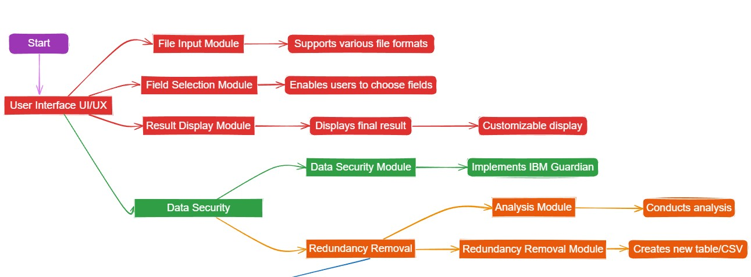
SYSTEM DIAGRAM
UI FLOWCHART
LINK: Data Redundancy Removal UI Flowchart
Page | 12

Slide 11
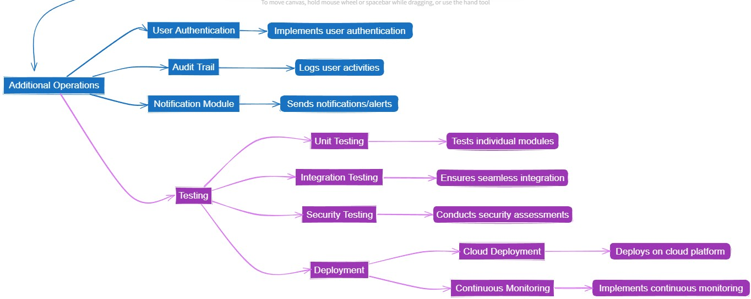
Redundancy Removal > Additional Operations

Slide 12
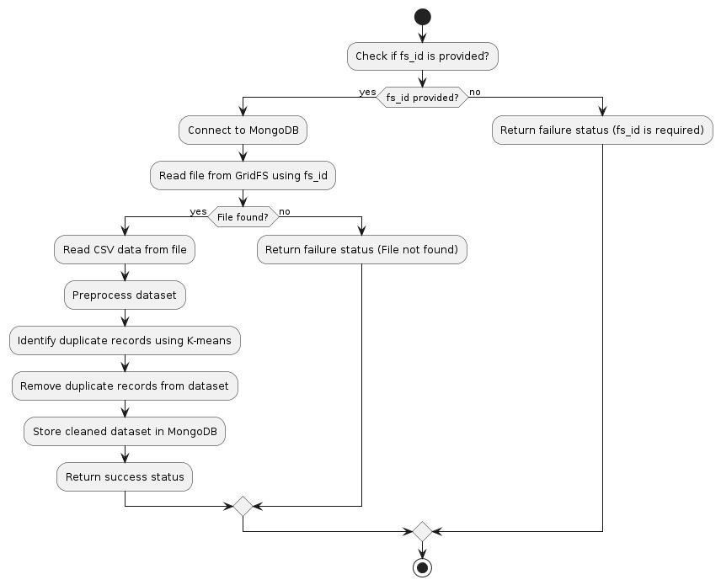
SYSTEM OVERVIEW FLOWCHART
[ML] CSV File Duplicate:
Page | 13

Slide 13
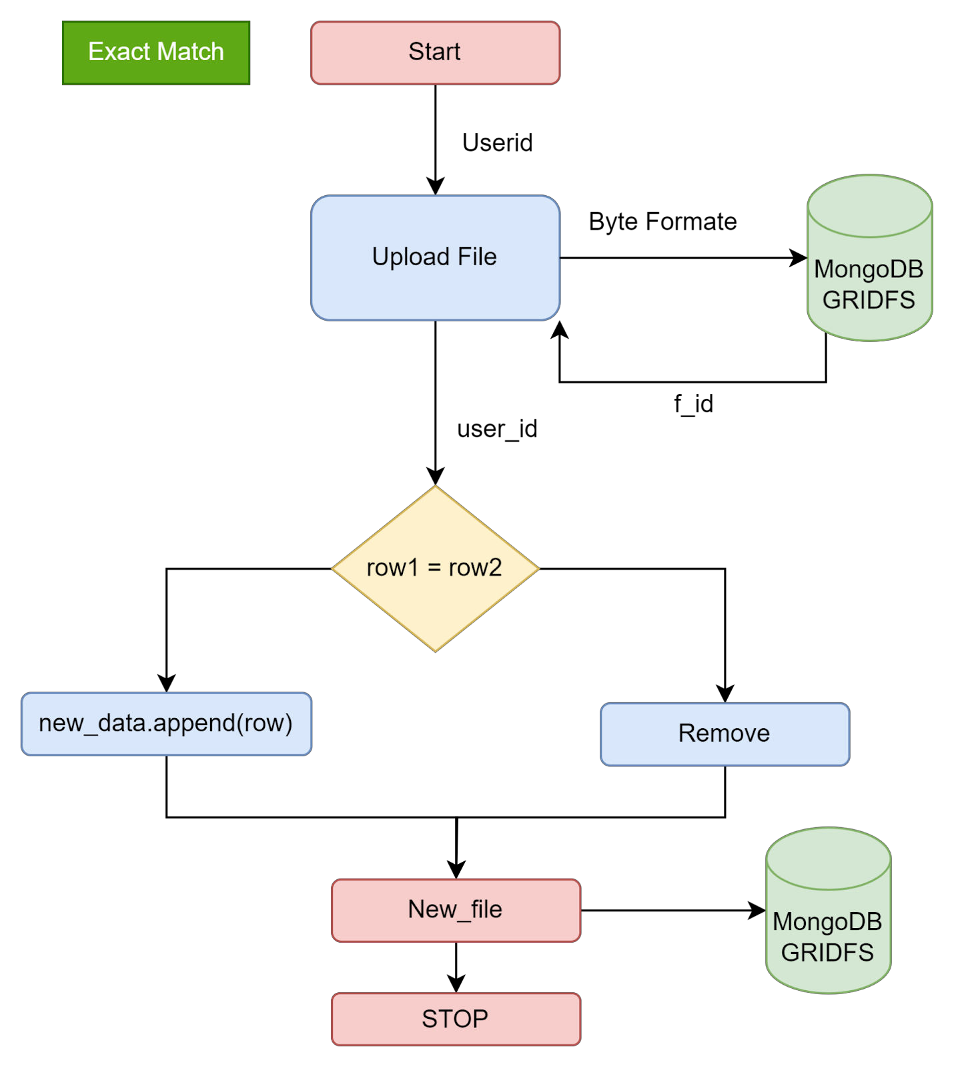
Exact Match Removal:
Page | 14

Slide 14
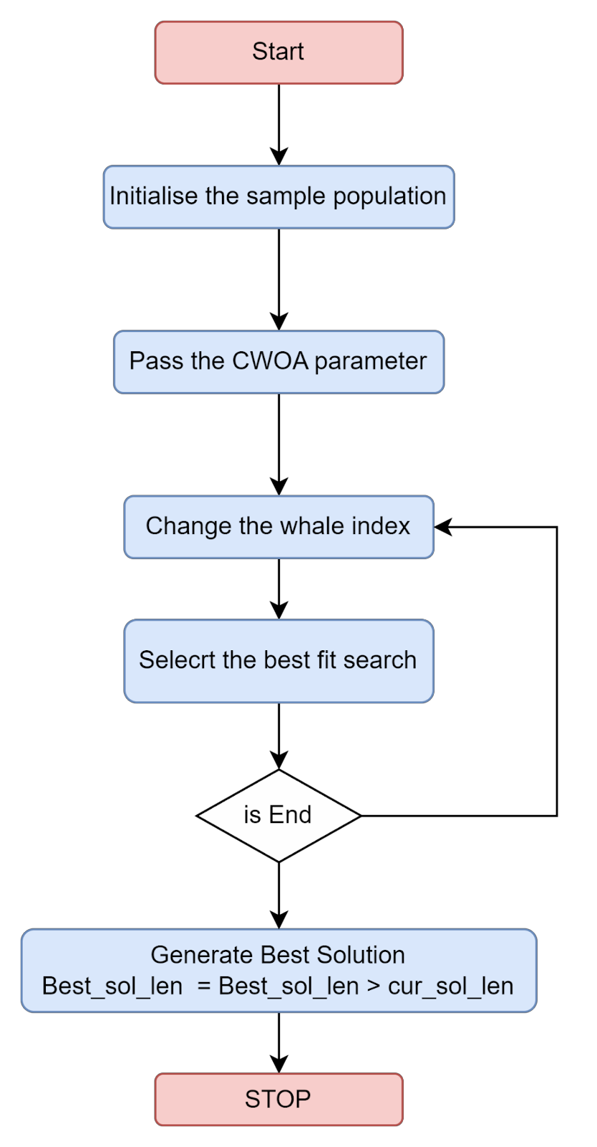
[Medical Industry Method] CWOA Method:
Page | 15

Slide 15
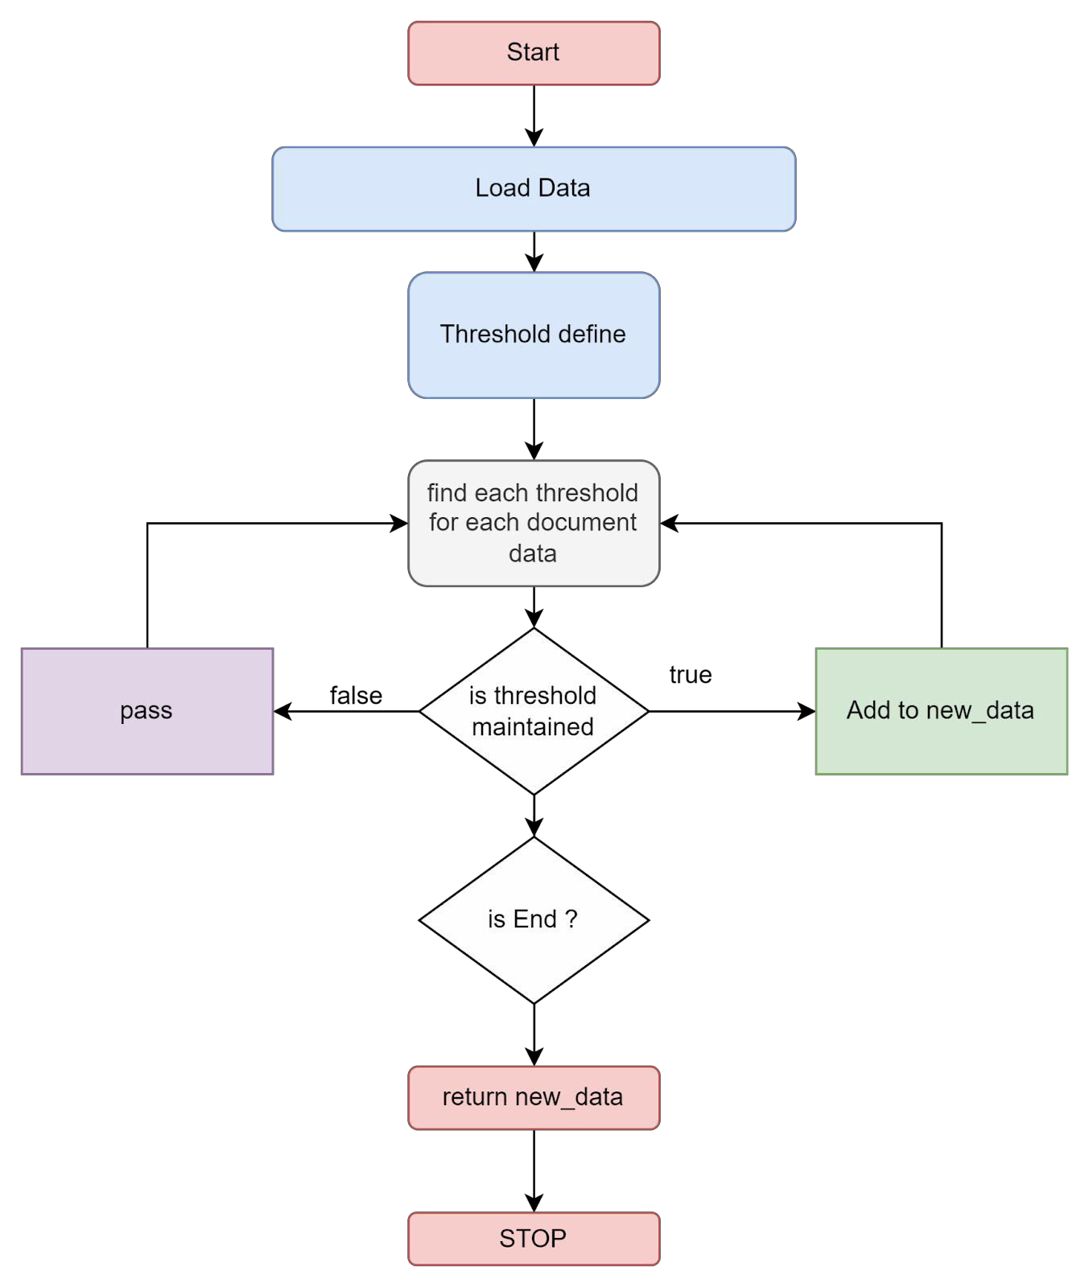
[Fuzzy Method] Data duplicate removal:
Page | 16

Slide 16
MongoDB Collection Structure
USERS
_id: user id ObjectID()
firstName: String
lastName : String
email: String
phone_number: String
password: SHA256() hash value
occupation: String
ProfilePhoto: Blob()
request: [{
fileUploadedAt: Date(), file_id: <GridFS_id>,
changes:[undo_perform, remove column, data_type_change],
}]
userCreatedAt: Date()
GridFS database
fileMetadata {file_id,finalename, datatype, storageType}
File Chunks
log_storage
log_id
log_title
log_content
createdAt
userid
module_title
Page | 17

Slide 17
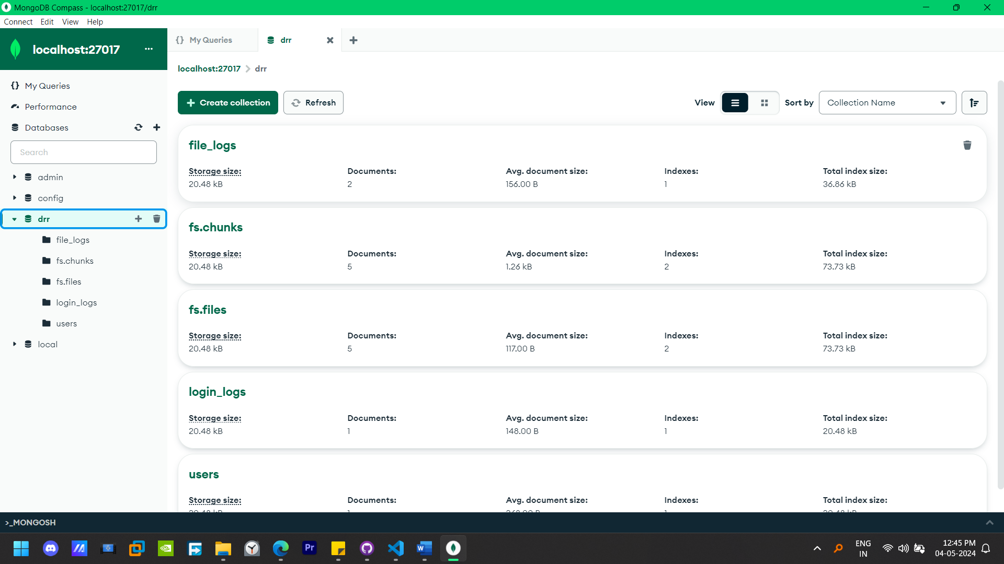
MongoDB Collection
Page | 27

Slide 18
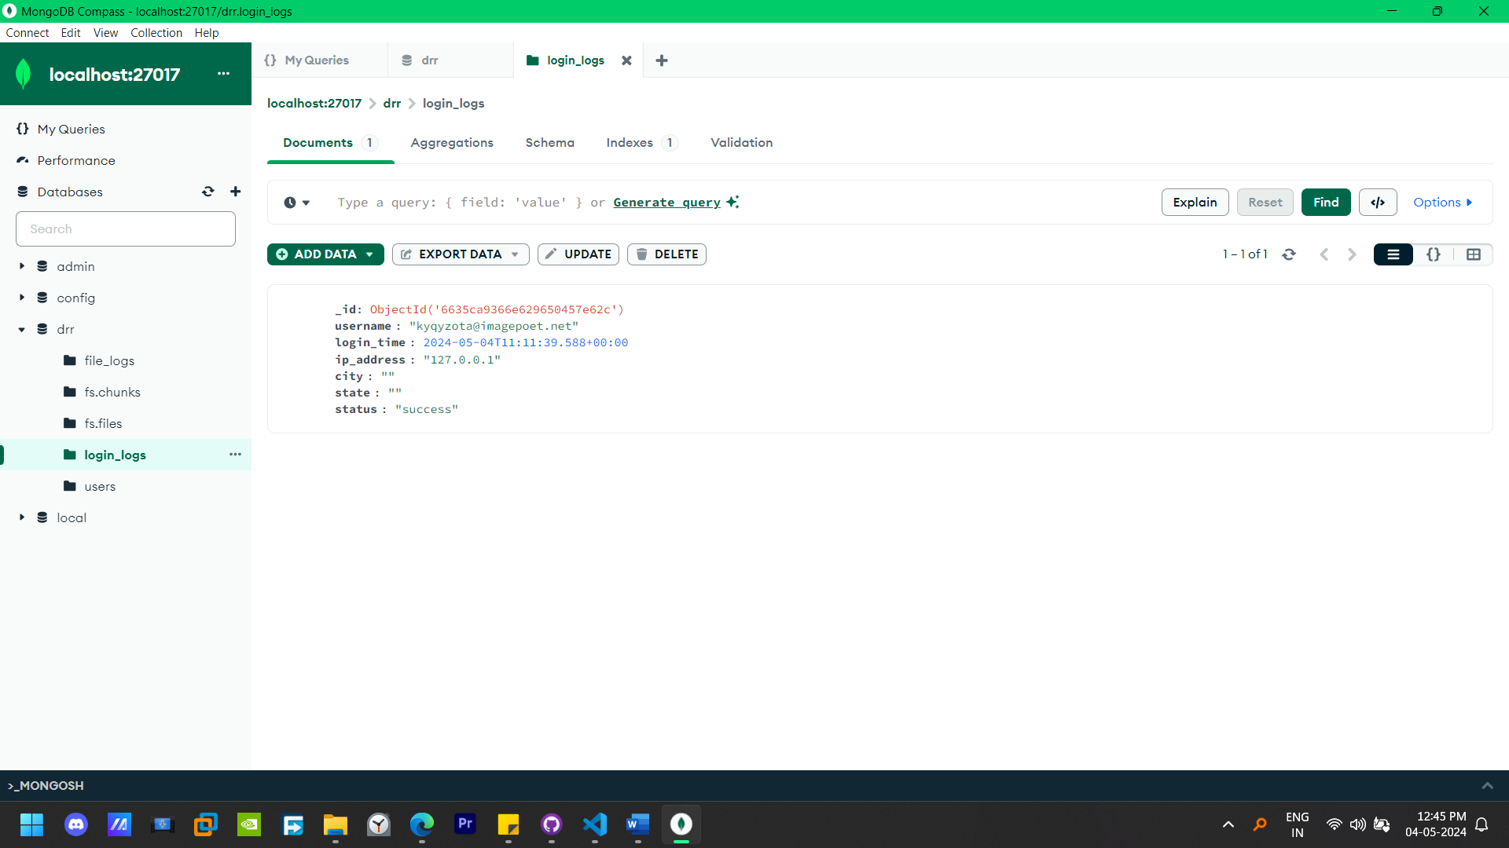

Slide 19
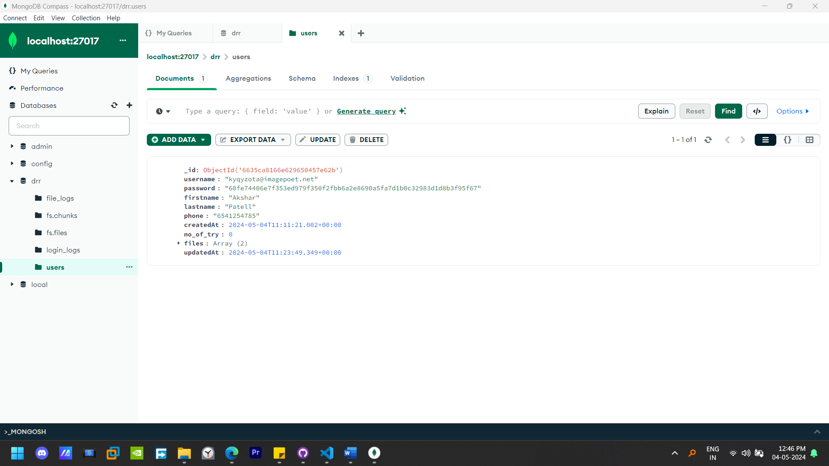

Slide 20
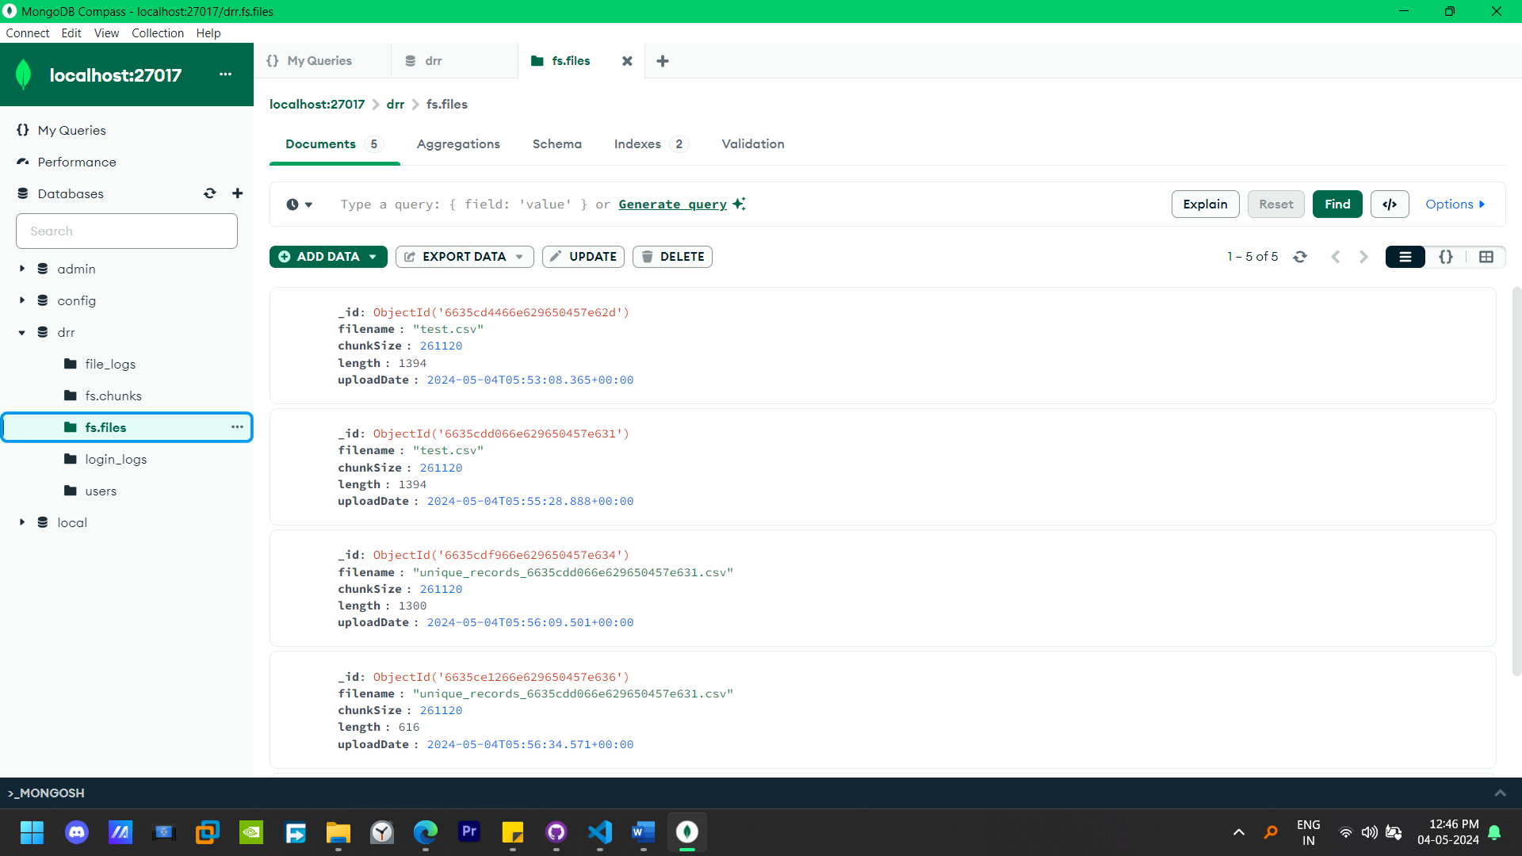

Slide 21
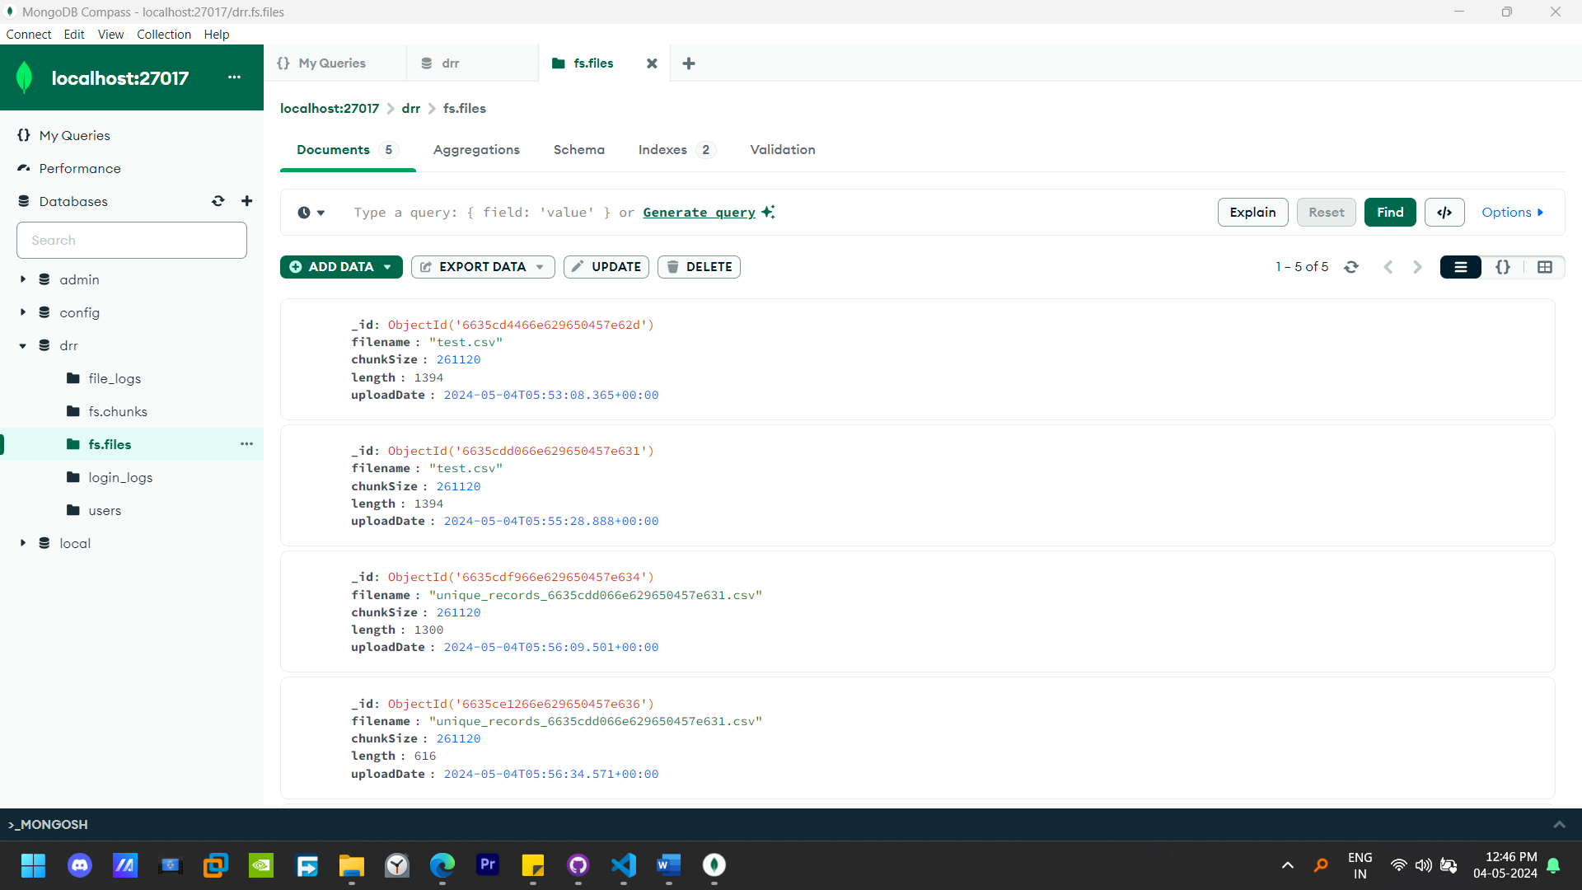

Slide 22
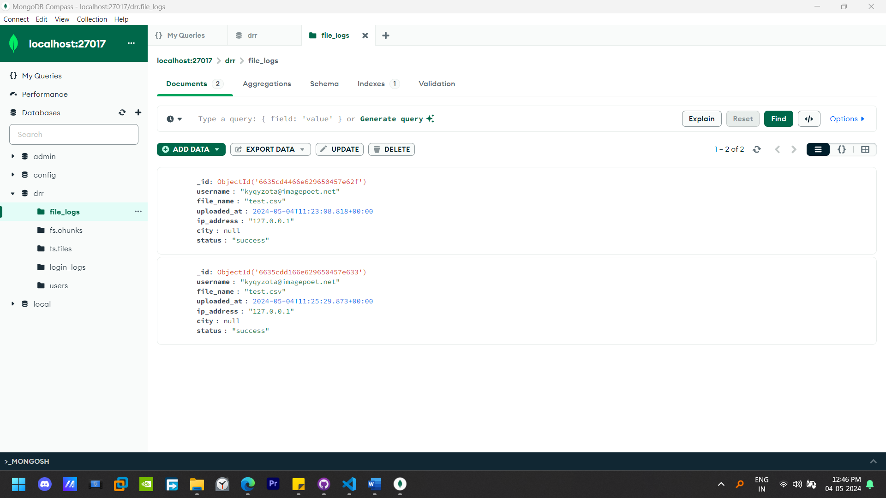

Slide 23
Deployment on AWS Cloud
Instance Details
Instance Type: | EC2 t2.micro
Instance Name: | drrs
Instance Platform: | Ubuntu
Platform Details: | Linux/UNIX – SERVER: NGINX
Page | 30

Slide 24
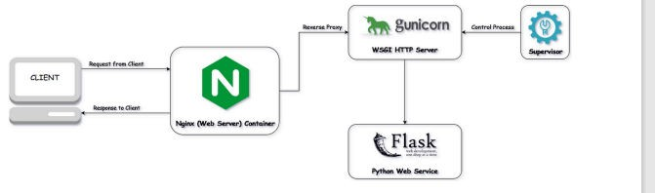
Load Balancing with Nginx and Gunicorn in a Django Application

Slide 25
Deployment on AWS Cloud (Continue.)
In our Django application, we employed a combination of Nginx and Gunicorn for efficient load balancing. This setup optimizes the distribution of incoming web traffic across multiple instances of our Django application, ensuring high availability, improved performance, and fault tolerance.
Nginx:
Nginx acts as a reverse proxy server, handling client requests and distributing them among multiple Guni corn workers. It efficiently manages incoming connections, optimizes resource utilization, and provides additional functionalities such as caching, SSL termination, and request routing.
By leveraging Nginx's event-driven architecture and asynchronous processing capabilities, we achieved low-latency response times and high throughput, even under heavy loads. Furthermore, Nginx's robust configuration options allowed us to fine-tune our load balancing strategy according to our application's specific requirements.
Gunicorn:
Gunicorn, short for Green Unicorn, serves as the WSGI HTTP server for our Django application. It interfaces between Nginx and the Django web framework, handling incoming requests, processing them, and generating responses. Gunicorn utilizes multiple worker processes to concurrently serve incoming requests, effectively utilizing the available system resources and maximizing performance.

Slide 26
Through Gunicorn's seamless integration with Django and its ability to scale horizontally by adding more worker processes or deploying multiple instances, we ensured scalability and responsiveness, even during periods of increased traffic or sudden spikes in demand.
Benefits:
Scalability: The combination of Nginx and Gunicorn allowed us to horizontally scale our Django application by adding more server instances or worker processes as needed, accommodating growing user traffic and maintaining consistent performance levels.
Fault Tolerance: By distributing incoming requests across multiple server instances, our load balancing setup enhanced the fault tolerance of our application, mitigating the impact of
server failures or downtime and ensuring uninterrupted service availability.
Performance Optimization: Nginx's efficient request handling and Gunicorn's multi- worker architecture optimized the performance of our Django application, delivering fast response times, low latency, and high throughput, even under heavy loads.
Page | 31

Slide 27
CONCLUSION
The project revolves around the development of a data redundancy removal system aimed at optimizing non-optimized .csv files. To achieve this, a suite of methods including MDNN removal, Exact match removal, Fuzzy match removal, CWOA Match removal, and Selected column removal are employed. These methods collectively serve to streamline the data by eliminating duplicate entries and enhancing data integrity.
Technologically, Python is utilized for scripting the system's functionalities, while MongoDB serves as the local database management system. Furthermore, AWS is leveraged for deploying the system publicly on the internet, making it accessible to users beyond local environments.
However, several constraints need to be addressed to ensure the system's effectiveness and viability. Performance optimization stands out as a primary concern due to the potentially large datasets the system will encounter. Scalability is also crucial to accommodate increasing loads and data volumes as the project gains traction. Additionally, robust data security measures are imperative to safeguard sensitive information processed by the system, both locally and in the cloud.
Furthermore, attention must be given to designing a user-friendly interface to facilitate seamless file uploading, method selection, and result visualization, enhancing overall user experience. Lastly, prudent cost management strategies must be implemented, especially concerning AWS usage, to optimize expenditure and ensure the project's financial sustainability in the long run. Addressing these constraints effectively is paramount for the successful implementation and widespread adoption of the data redundancy removal system.
Page | 33

Slide 28
REFRENCES
https://bhuvan.nrsc.gov.in/hackathon/iisf2023/topics/Topic12.pdf
[An approach to remove duplication records in healthcare dataset based on Mimic Deep Neural Network (MDNN) and Chaotic Whale Optimization (CWO)] Anto Praveena M.D, and Bharathi B, https://journals.sagepub.com/doi/pdf/10.1177/1063293X21992014
GRIDFS-FILE Management MongoDB: https://www.mongodb.com/docs/manual/core/gridfs/
Pandas library of Python: https://pandas.pydata.org/docs/getting_started/index.html
DEDUPLICATING DATA AND REMOVING REDUNDANCY IN CLOUD - Arun Singh Kaurav, T.Santhosh Kumar, V.Yadigiri Assistant Professor, Assistant Professor, Assistant Professor Computer Science and Engineering Guru Nanak Institutions Technical Campus, Hyderabad, India https://www.ijcrt.org/papers/IJCRT1892578.pdf
https://www.digitalocean.com/community/tutorials/how-to-set-up-django-with-postgres-nginx-and- gunicorn-on-ubuntu, Erin Glass, Jamon Camisso, and Easha Abid
Page | 34

